Slide 1
The Battle of the Neighborhoods – NYC Italian Restaurants
Nicholas Peters

Slide 2

Why Italian Restaurants in NYC?
New York City has the largest population of Italian Americans in all of North America
I come from a long line of Italian restaurateurs, many of whom immigrated to New York City back in the early 20th century
My siblings are going into the family business, so I thought I could help them find the best location to start their restaurant
I want to find them a neighborhood in one of the five boroughs to set up shop that has the best average rating and not too much competition from other Italian restaurants

Slide 3
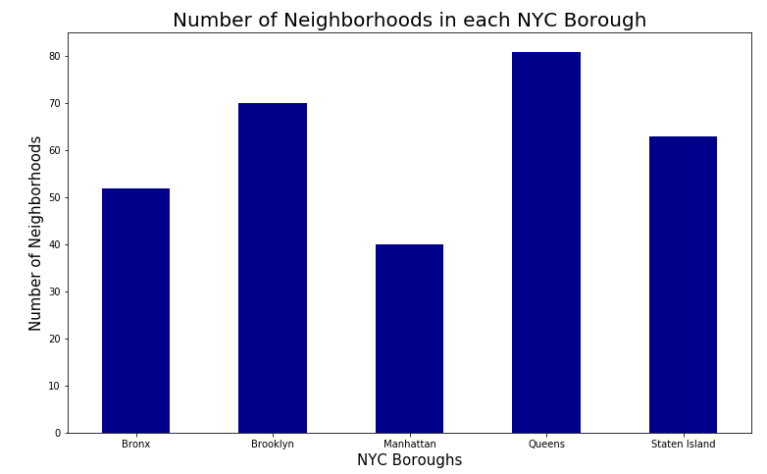
The New York City Boroughs
Shown to the left is the number of neighborhoods in the five NYC boroughs: Bronx, Brooklyn, Manhattan, Queens, and Staten Island
As seen, Manhattan has the least amount of neighborhoods – however, it has been known to have many Italian Americans. It has almost a third of the Italian American population in New York City (almost 1 million!)
Manhattan has a large population density of Italian Americans, making it an ideal spot for an Italian restaurant – many potential customers!

Slide 4
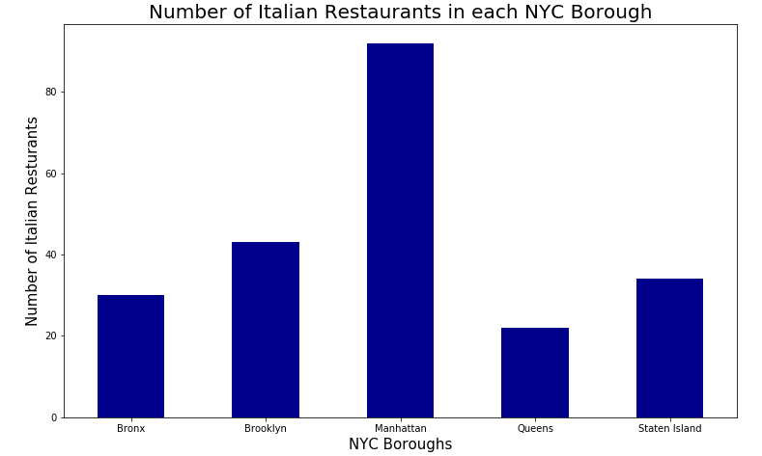
Italian Restaurants in NYC Boroughs
Shown to the left is the number of Italian restaurants in each of the five NYC boroughs
Manhattan has the highest number of Italian restaurants, which makes sense, as Manhattan has almost 1 million Italian Americans!
Manhattan seems like the best choice in boroughs so far – hopefully further research supports this choice

Slide 5
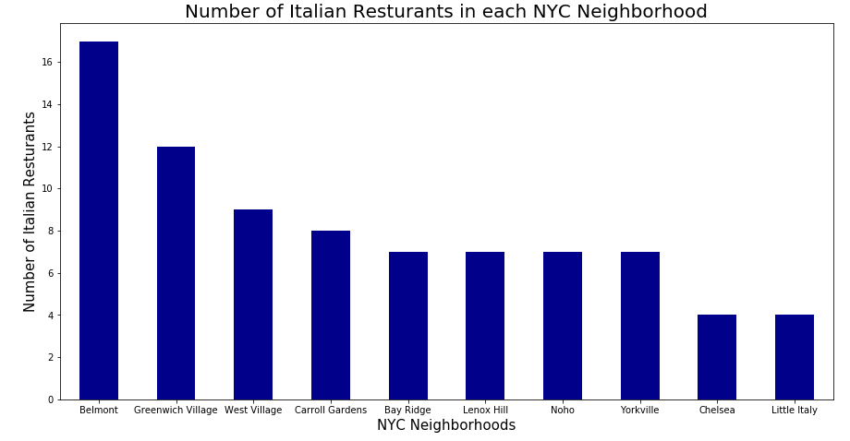
Italian Restaurants in NYC Neighborhoods
Shown to the left is the number of Italian restaurants in 10 of the most popular NYC neighborhoods for Italian restaurants
7 out of 10 of these neighborhoods listed are located in Manhattan: Greenwich Village, West Village, Lenox Hill, Noho, Yorkville, Little Italy, and Chelsea
It seems like Manhattan is indeed the hot spot for Italian restaurants!
There will be a lot of competition, though, especially in Greenwich Village and West Village, so it would be best to focus on the other 5 Manhattan neighborhoods that have about half the competition

Slide 6
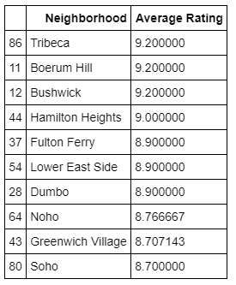
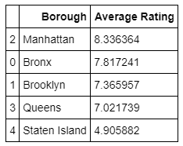
Italian Restaurant Average Ratings in NYC
The average ratings for Italian restaurants in each of the five NYC boroughs are shown to the far left
As seen, Manhattan has the highest average rating for Italian restaurants!
In the table to the close left, 6 of the 10 neighborhoods that have the highest average rating for Italian restaurants are located in Manhattan: Tribeca, Hamilton Heights, Lower East Side, Noho, Greenwich Village, and Soho
Note, only Noho and Greenwich Village have more than two Italian restaurants, all the other Manhattan neighborhoods either have one or two Italian restaurants – although their ratings may be higher (with exception of Soho), they may not be well known for Italian food
Meanwhile, Noho and Greenwich Village have 6 and 12 Italian restaurants, respectively, which can lead to new potential customers visiting a neighborhood known for its Italian food
Note, Greenwich Village, however, has too much competition, which may prevent good business

Slide 7

Best NYC Neighborhood to Start an Italian Restaurant?
After the analysis of all the data, Noho is the best neighborhood within New York City to start an Italian restaurant
Noho already has 6 pre-existing Italian restaurants, which is not too high and not too low – there will be competition, but not enough to prevent business and enough so that will attract new potential customers
Noho also has an average rating of 8.76, which is really good and is the fourth highest overall average rating in New York City
Note, these findings are based on the data provided by Foursquare API and others, so if data from other sources were used, the conclusions may differ
Based on the data used in this report, I will let my siblings know the results
Keep an eye out for their restaurant in Noho in a few years! It will be called Rossi Romano!

